Slide 1


Keylogger Defender Tool
Protect your systems against stealthy keylogging attacks.
Presented by Your Name, College Name & Department, Date.
by Hitansh Mangla

Slide 2

Objective of the Keylogger Defender Tool
Purpose
Detect and prevent unauthorized keystroke logging on devices.
Necessity
Keylogging attacks steal sensitive data silently, risking privacy.

Slide 3
Understanding Keylogger Attacks
How Keyloggers Work
Risks
They record every keystroke to capture passwords and data.
Leads to data theft, identity fraud, and privacy violation.
Software keyloggers run unnoticed on the system.
Hardware keyloggers connect physically to devices.

Slide 4
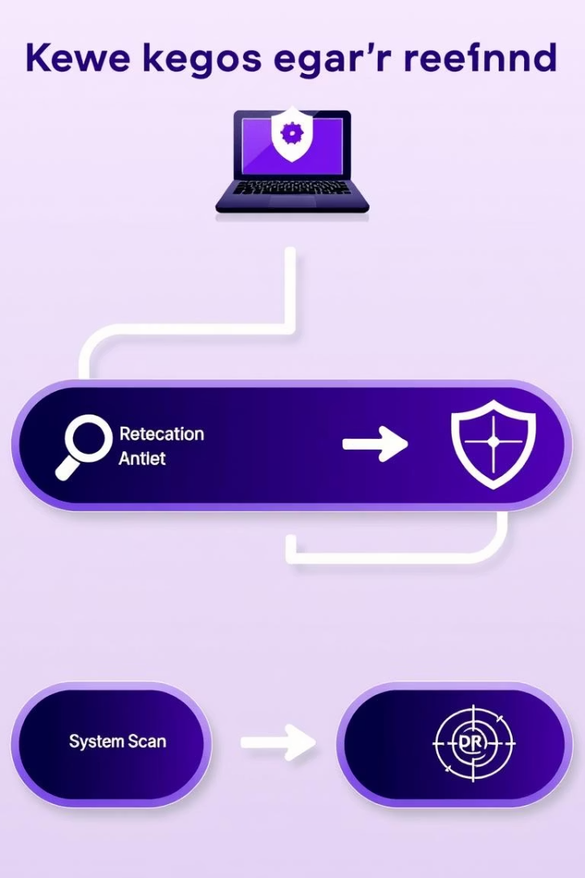




Working Process of the Tool
Keylogger Captures Keystrokes
Data Sent to Flask Server
Every 30 seconds, logs are transmitted securely.
GUI Displays Received Files
User-friendly interface shows logs for review.
Detection Program Analyzes Network
Monitors unusual traffic indicating keylogger activity.

Slide 5
Components & Technical Details
Keylogger (C#)
Flask Server (Python)
GUI (Python)
Detection Program (Python)
Captures keystrokes and saves to a text file locally.
Displays folders with incoming log files for easy access.
Receives and stores keylog files via network.
Inspects network activity to identify keylogger presence.

Slide 6

Challenges Faced During Development
Technical Hurdles
Data Transmission
Securely capturing keystrokes without detection was complex.
Maintaining privacy while sending logs reliably posed issues.
Integration Debugging
Synchronizing keylogger, server, and GUI demanded thorough testing.

Slide 7

Future Enhancements for Keylogger Defender
Advanced Detection
Tool Integrations
Implement AI to detect sophisticated and evolving keyloggers.
Combine with antivirus and firewall systems for layered defense.
Real-Time Alerts
Notify users instantly upon suspicious keylogging activity.

Slide 8

Conclusion
The Keylogger Defender Tool safeguards sensitive data from stealth attacks.
It enhances cybersecurity by monitoring keystrokes, network activity, and displaying logs clearly.

Slide 9

Questions & Answers
We welcome your questions and feedback about our Keylogger Defender Tool.

Slide 10

Thank You
Appreciate your time and interest in improving cybersecurity together.

